Slide 1


Carlos Isaac
14-07-2023

Slide 2
Outline
Executive Summary
Introduction
Methodology
Results
Conclusion
Appendix

Slide 3
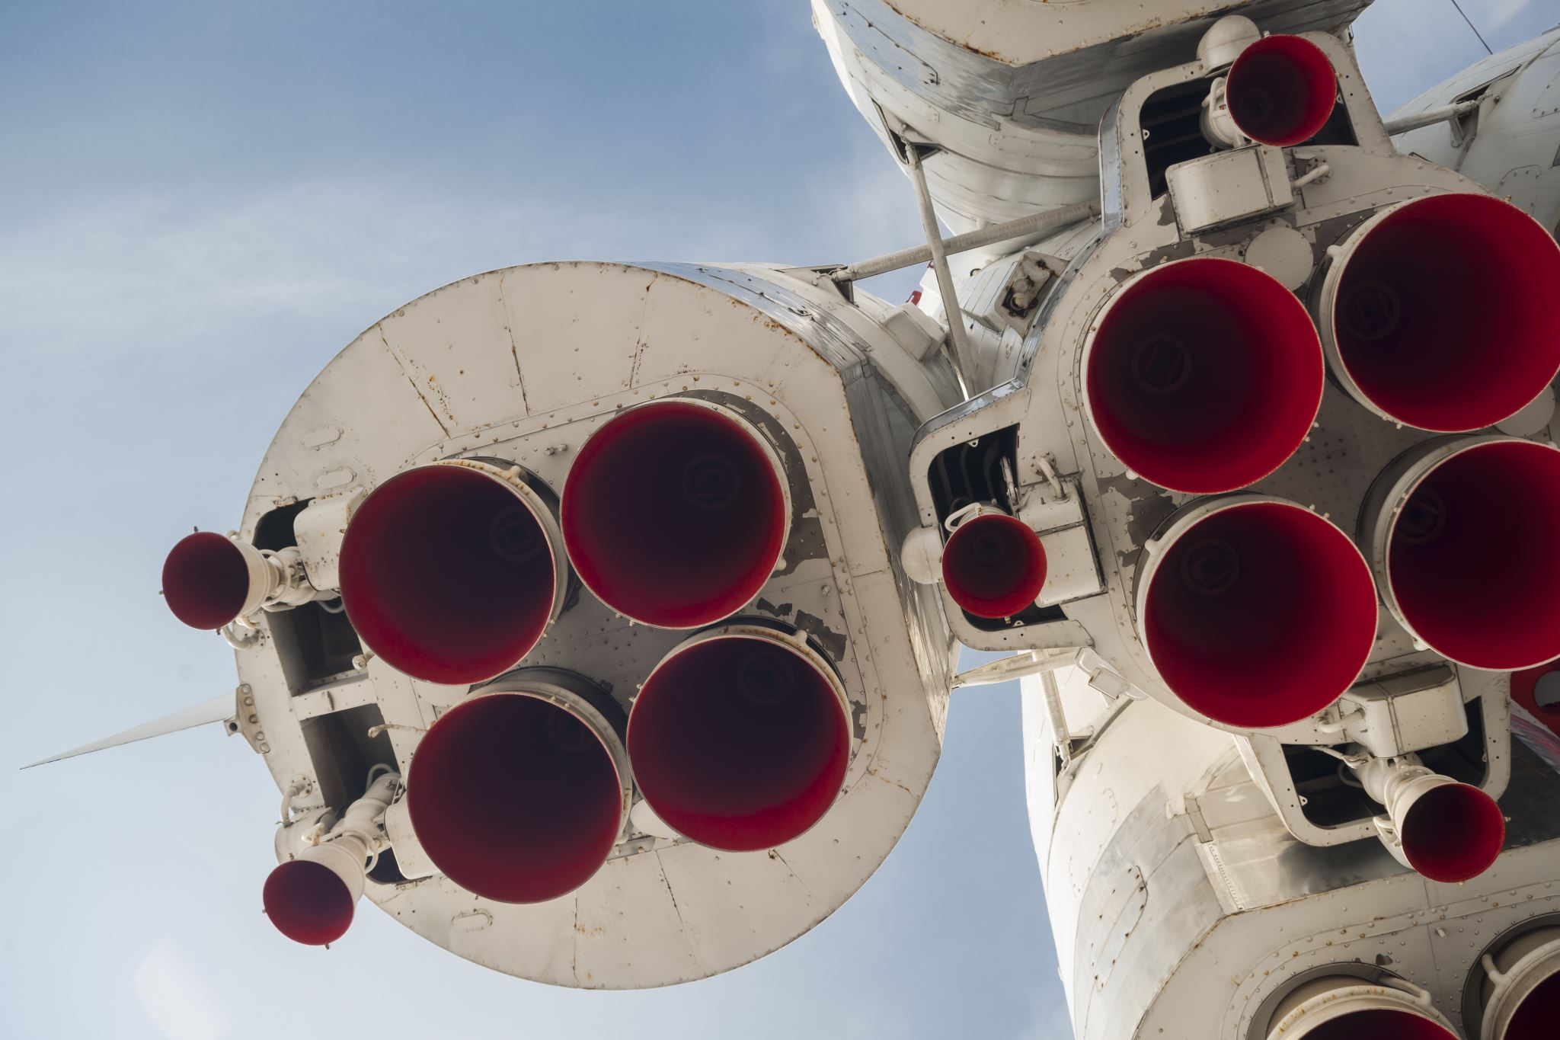
Executive Summary
The "SpaceX Falcon 9 First Stage Landing Prediction" project focused on predicting the landing success of SpaceX's Falcon 9 rocket's first stage. This analysis is crucial for understanding the cost-saving potential of reusable rocket technology, which is a significant competitive advantage in the aerospace industry.
In this project, we employed data analysis techniques and machine learning to build a predictive model. Data was collected from various sources, including SpaceX's API and a Wikipedia page with Falcon 9 launch records. Following data collection, we conducted a comprehensive exploratory analysis to better understand the data and prepare it for modeling.
During the modeling stage, we leveraged a diverse set of feature engineering techniques and trained a machine learning model with this data. The model was validated and optimized to provide the best possible predictions.
The results of the project provided insightful findings about the factors that might influence the success of Falcon 9's first stage landing. These findings hold the potential to enhance our understanding of SpaceX's cost structures and operational efficiencies, which is crucial information for any competitor in the aerospace market.

Slide 4

Introduction
The aerospace industry is experiencing a paradigm shift with the advent of reusable rockets. A leader in this space is SpaceX, whose Falcon 9 rocket has been designed with reusability in mind. A key aspect of this reusability is the successful landing of the first stage of the Falcon 9. Understanding the factors that influence the success of these landings could provide invaluable insights into the operational efficiencies and cost structures of SpaceX.
This project, "SpaceX Falcon 9 First Stage Landing Prediction", was undertaken with the goal of predicting the success of Falcon 9's first stage landing. We embarked on this journey with the aim to unearth the elements contributing to the successful or unsuccessful landings, and to provide an analytical basis to potentially compete in this rapidly evolving market.
To achieve this, we collected and analyzed data from various SpaceX launches, conducted an exploratory data analysis, built and validated a predictive model using machine learning, and extracted actionable insights from the results.
In the subsequent sections, we will delve deeper into the specific methodologies we used, the results we obtained, and the conclusions we drew from this project.

Slide 5

Section 1

Slide 6

Methodology
Executive Summary:
The methodology employed in this project was a multi-step process that involved data collection, data preprocessing, exploratory data analysis, feature engineering, model building, and results interpretation.
Data collection methodology:
The data was collected from two primary sources: SpaceX's API and a Wikipedia page containing records of Falcon 9 launches.
Perform data wrangling
The collected data was cleaned and preprocessed. This involved handling missing values, converting data types, and filtering the data to focus on Falcon 9 launches.
Perform exploratory data analysis (EDA) using visualization and SQL
Perform interactive visual analytics using Folium and Plotly Dash
Perform predictive analysis using classification models
We built a machine learning model to predict the success of the Falcon 9 first stage landing. The model was trained on the preprocessed and engineered features. The performance of the model was validated and optimized.

Slide 7
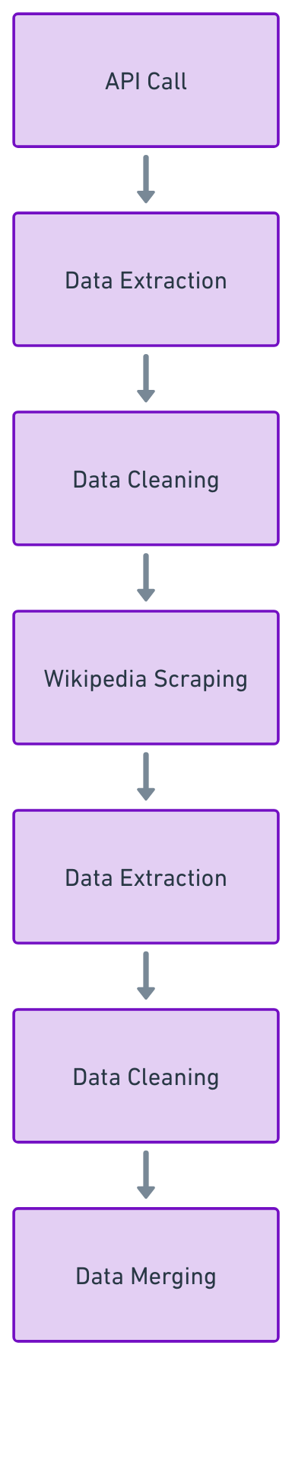
Data Collection
For this project, the data was collected from two primary sources: SpaceX's API and a Wikipedia page containing Falcon 9 launch records.
The data gathering process was a combination of API calls and web scraping techniques.
Initially, SpaceX's API was used to pull relevant launch data. This data included important details about each launch, such as the payload, orbit type, launch site, and the outcome of the first stage landing.
To complement the API data, additional launch records were obtained by scraping a Wikipedia page.
Both sets of data were cleaned and merged to form a comprehensive dataset that was used for further analysis and modeling.

Slide 8
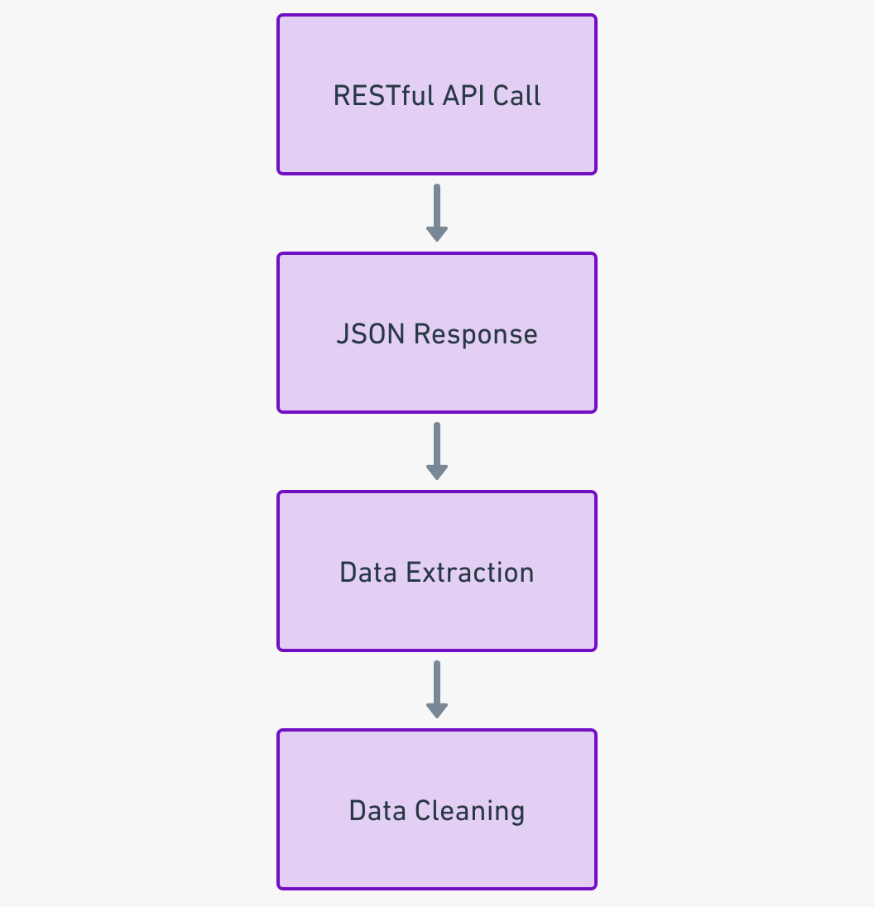
Data Collection – SpaceX API
The SpaceX API was a significant source of data for this project.
The data collection process involved making RESTful API calls to SpaceX's 'launches' endpoint.
The response from each API call was a JSON object containing detailed information about a specific launch.
Key pieces of information were extracted from the JSON object, such as the payload mass, orbit type, launch site, and landing outcome.
This data was then cleaned and processed for further analysis.
The code for the SpaceX API calls can be found at: Data-Science-Projects-With-Python/SpaceX_Project_Notebooks/1-API-Data-Collection_SpaceX.ipynb at main · carlosisaacfaura/Data-Science-Projects-With-Python (github.com)

Slide 9
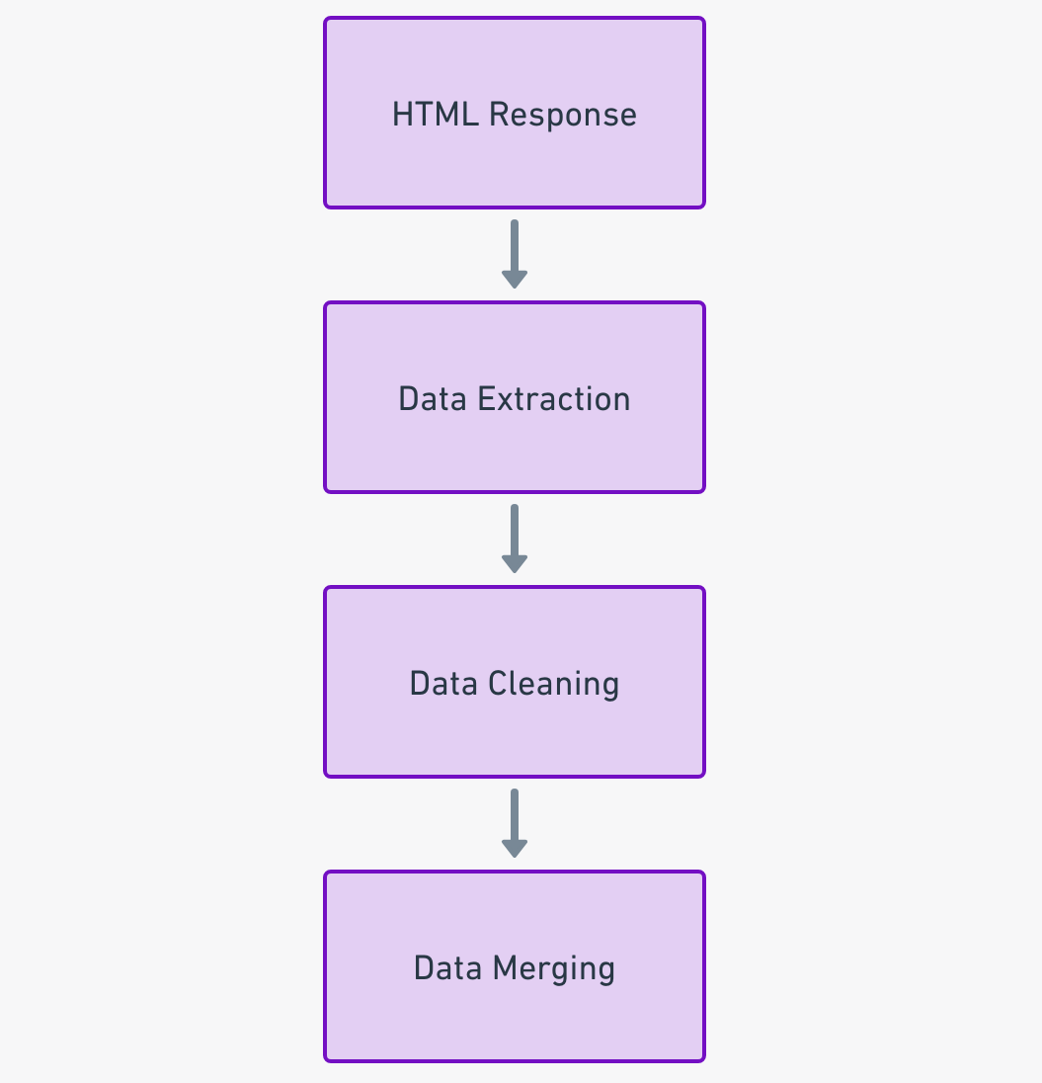
Data Collection - Scraping
In addition to the API data, further data was collected by scraping a Wikipedia page containing Falcon 9 launch records.
The web scraping process involved sending a GET request to the Wikipedia page URL and parsing the HTML response to extract the required data.
The data was then cleaned, processed, and merged with the API data to create a comprehensive dataset for analysis.
The code for the web scraping process can be found at: Data-Science-Projects-With-Python/SpaceX_Project_Notebooks/2-WebScraping-Data-Collection_SpaceX.ipynb at main · carlosisaacfaura/Data-Science-Projects-With-Python (github.com)

Slide 10
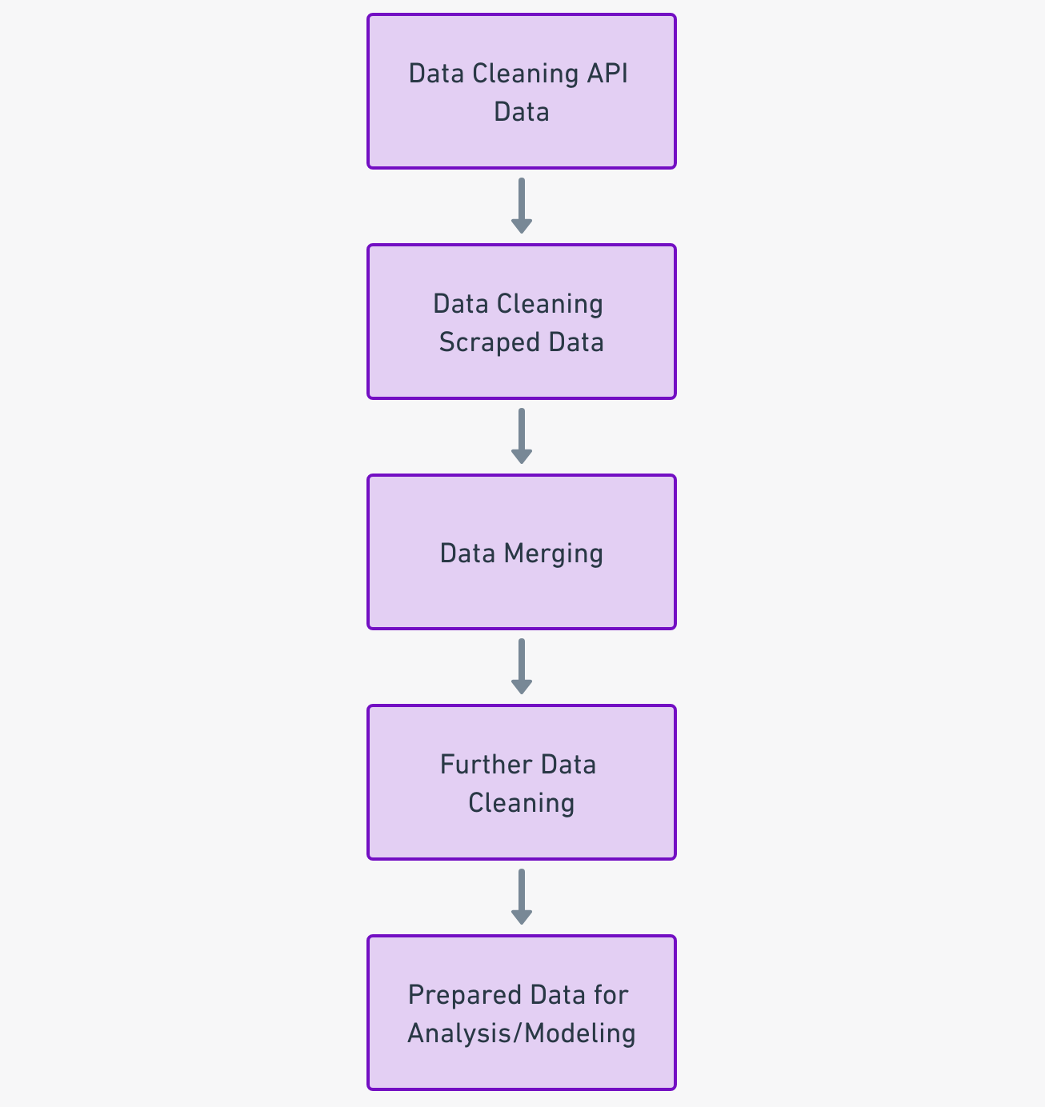
Data Wrangling
The data wrangling process was a key step in preparing the collected data for analysis and modeling.
Initially, the data collected from the SpaceX API and Wikipedia scraping were cleaned separately. This involved handling missing values, correcting data types, and standardizing the format of the data.
The cleaned datasets were then merged to create a comprehensive dataset that included all relevant information about each Falcon 9 launch.
Further data cleaning was performed on the merged dataset. This included removing any remaining irrelevant or redundant data, dealing with any outliers, and ensuring consistency across the dataset.
Finally, the cleaned dataset was used for exploratory data analysis and model building.
The code for the data wrangling process can be found at: Data-Science-Projects-With-Python/SpaceX_Project_Notebooks/3-Data-Wrangling_SpaceX.ipynb at main · carlosisaacfaura/Data-Science-Projects-With-Python (github.com)

Slide 11

EDA with Data Visualization
The Exploratory Data Analysis (EDA) stage involved generating various charts to better understand the data and uncover patterns, relationships, and trends.
A variety of charts were used, each serving a specific purpose:
Bar charts and pie charts: These were used to visualize the distribution of categorical variables, such as the launch site and orbit type. This helped understand the frequency of different categories in the data.
Histograms: These were used to visualize the distribution of continuous variables, such as payload mass. This helped understand the range and skewness of these variables.
Scatter plots and line plots: These were used to visualize relationships between different variables. For instance, the relationship between flight number and launch site.
Heatmaps: These were used to visualize the correlation between different numerical variables. This helped identify variables that might influence the landing success.
These visualizations provided valuable insights into the data and guided the feature engineering and model building stages.
The code for the EDA with data visualization process can be found at: Data-Science-Projects-With-Python/SpaceX_Project_Notebooks/5-EDA-Pandas-Matplotlib.ipynb at main · carlosisaacfaura/Data-Science-Projects-With-Python (github.com)

Slide 12
EDA with SQL
Several SQL queries were performed as part of the EDA to extract useful information and insights from the data. Here are the key queries that were executed:
Count Query: To count the total number of launches, successful landings, and specific orbit types.
Group By Query: To group data by launch site and orbit type, and calculate statistics like the average payload mass.
Join Query: To join different tables and create a comprehensive dataset for analysis.
Where Query: To filter the data based on certain conditions, such as specific orbit types or launch outcomes.
Order By Query: To sort the data based on certain variables, like flight number or launch date.
These queries helped further understand the data and guided the decision-making process in the subsequent stages of the project.
The code for the EDA with SQL can be found at: Data-Science-Projects-With-Python/SpaceX_Project_Notebooks/4-EDA-SQL_SpaceX.ipynb at main · carlosisaacfaura/Data-Science-Projects-With-Python (github.com)

Slide 13

Build an Interactive Map with Folium
To better visualize the geographic data related to the launch sites, an interactive map was created using Folium.
The following objects were added to the map:
Markers: Markers were added to represent the location of each launch site. This provided a visual representation of where SpaceX launches its rockets from.
Circles: Circles were added around each marker to represent the area of influence or operational range of each launch site. The size of each circle was determined based on the number of launches from each site.
Lines: Lines were added to connect different launch sites with railways, highways and coasts so we can find patterns with this visualization.
The addition of these objects to the map greatly enhanced the visualization of the launch site data and provided additional context to the analysis.
The code for the interactive map with Folium can be found at: Data-Science-Projects-With-Python/SpaceX_Project_Notebooks/6-Visualization_Folium-Launch-Location_SpaceX.ipynb at main · carlosisaacfaura/Data-Science-Projects-With-Python (github.com)

Slide 14

Build a Dashboard with Plotly Dash
The dashboard was built using Plotly Dash, a Python framework for creating interactive web applications. It included several interactive elements and visualizations to explore SpaceX launch data.
The following plots and interactions were included in the dashboard:
Dropdown: A dropdown list was added to enable selection of a specific launch site or all launch sites. This allowed the user to filter the data and visualizations based on the selected site.
Pie Chart: A pie chart was added to show the total successful launches count for all sites. When a specific launch site was selected in the dropdown, the pie chart updated to show the success vs. failed counts for the selected site.
Range Slider: A slider was added to select a range for the payload mass (in kg). This allowed the user to filter the data and visualizations based on the selected payload range.
Scatter Plot: A scatter plot was added to show the correlation between payload mass and launch success. The scatter plot updated based on the selected launch site and payload range.
The addition of these plots and interactions allowed for a dynamic and interactive exploration of the SpaceX launch data. This helped uncover insights and patterns in the data that might not be apparent from static visualizations alone.
The code for the interactive dashboard with Plotly Dash can be found at: Data-Science-Projects-With-Python/SpaceX_Project_Notebooks/7-Visualization-Plotly-Dash_Spacex.py at main · carlosisaacfaura/Data-Science-Projects-With-Python (github.com)

Slide 15
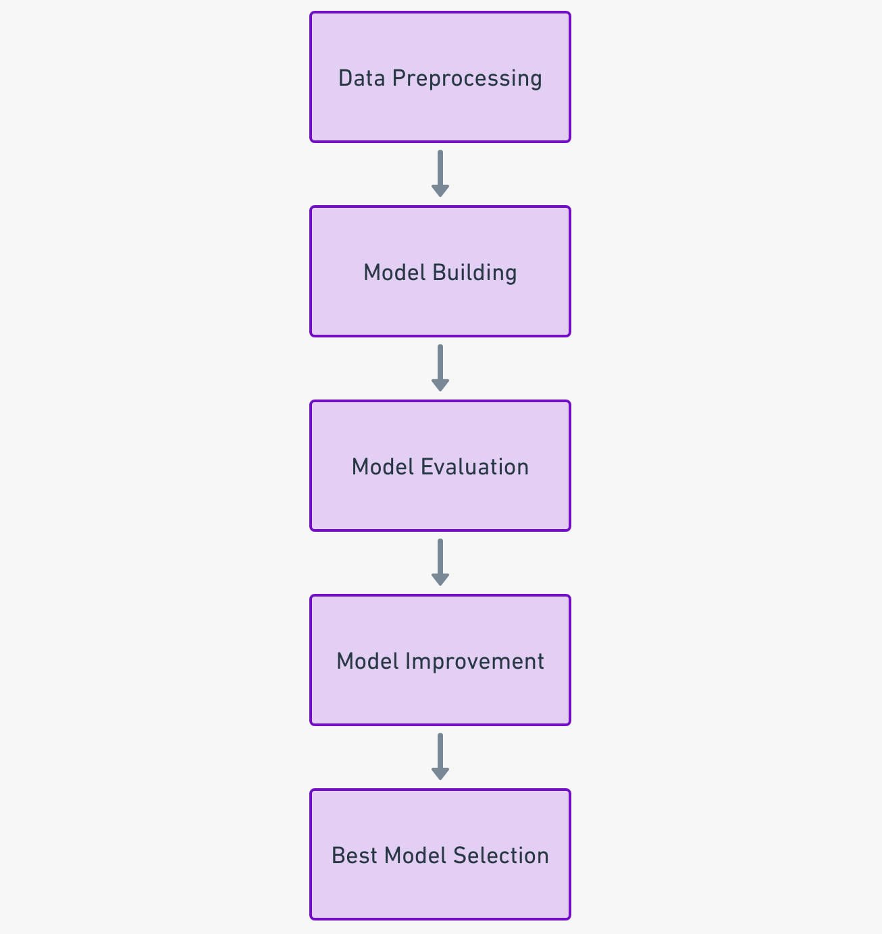
Predictive Analysis (Classification)
Our predictive analysis was conducted using four popular classification algorithms: Logistic Regression, Support Vector Machines (SVM), Decision Tree, and K-Nearest Neighbors (KNN).
The following steps were taken in the model development process:
Data Preprocessing: The data was cleaned and preprocessed to ensure the best possible inputs for our models.
Model Building: We trained each model on the training dataset, adjusting for model parameters to optimize performance.
Model Evaluation: Each model was evaluated using the test dataset and the accuracy metric. The accuracy metrics on the test set for each model were as follows:
Logistic Regression: 0.8333
SVM: 0.8333
Decision Tree: 0.8333
KNN: 0.8333
Model Improvement: We iterated on the model building and evaluation process, tuning parameters to improve the performance of our models.
Best Model Selection: Given the accuracy scores, all models performed similarly on the test dataset. However, other factors such as model interpretability, training time, and simplicity were considered. For instance, the Logistic Regression model, being simpler and more interpretable, could be a preferred choice in certain applications.
The entire predictive analysis can be reviewed in detail at our GitHub repository: Data-Science-Projects-With-Python/SpaceX_Project_Notebooks/8-Machine-Learning_SpaceX.ipynb at main · carlosisaacfaura/Data-Science-Projects-With-Python (github.com)

Slide 16
Results
Exploratory data analysis results
Interactive analytics demo in screenshots
Predictive analysis results

Slide 17

Section 2

Slide 18
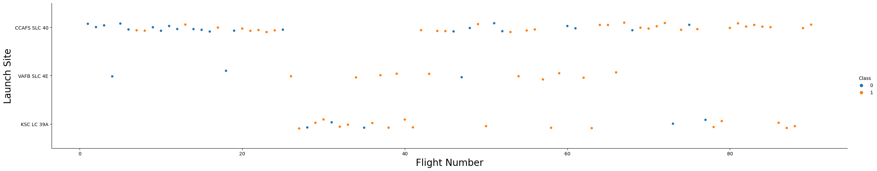
Flight Number vs. Launch Site
This scatter plot visualizes the distribution of SpaceX's rocket launch attempts over time, categorizing them based on the launch site. Each point on the plot represents a unique flight. The position on the x-axis corresponds to the flight number, which effectively also represents the chronological order of flights. The y-axis, on the other hand, shows the launch site from which each flight was launched.
The color of each point indicates whether the launch was successful or not. Orange dots represent successful launches (Class 1), and blue dots represent unsuccessful ones (Class 0).
Key takeaways from this visualization:
Launch Distribution: SpaceX has been using three launch sites - KSC LC 39A, VAFB SLC 4E, and CCAFS SLC 40. CCAFS SLC 40 is the most frequently used, followed by KSC LC 39A.
Success Rate Over Time: SpaceX's success rate appears to have improved over time, with the proportion of orange dots (successful launches) increasing with flight number.
Success Rate by Launch Site: All three sites have a mix of successful and unsuccessful launches. However, VAFB SLC 4E appears to have a higher proportion of successful launches compared to the other two sites.

Slide 19
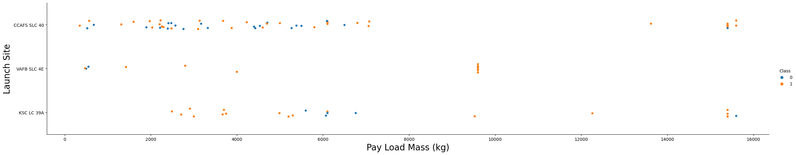
Payload vs. Launch Site
This scatter plot visualizes the distribution of SpaceX's rocket launch attempts, categorizing them based on the launch site and the payload mass. Each point on the plot represents a unique flight. The position on the x-axis corresponds to the payload mass, and the y-axis shows the launch site from which each flight was launched.
The color of each point indicates whether the launch was successful or not. Orange dots represent successful launches (Class 1), and blue dots represent unsuccessful ones (Class 0).
Key takeaways from this visualization:
Payload Distribution: SpaceX has launched a wide range of payloads, from very light to very heavy. Most payloads fall within the middle of the range, with fewer very light or very heavy payloads.
Success Rate by Payload: There is no clear correlation between payload mass and success rate. Both light and heavy payloads have a mix of successful and unsuccessful launches.
Success Rate by Launch Site: All three launch sites have a mix of successful and unsuccessful launches across a wide range of payload masses. However, VAFB SLC 4E appears to have a higher proportion of successful launches compared to the other two sites and also we can notice it has no launches for heavy payload mass (greater than 10000).

Slide 20
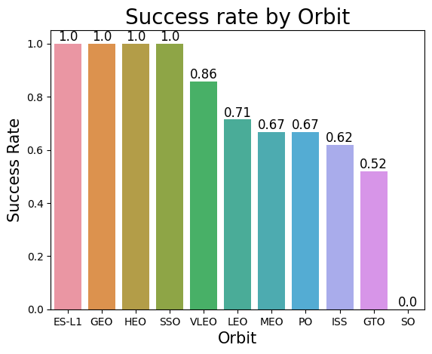
Success Rate vs. Orbit Type
This bar chart illustrates the success rate of SpaceX's rocket launches in relation to the orbit type. Each bar represents a specific orbit type. The height of the bar corresponds to the success rate for launches to that orbit.
Key takeaways from this visualization:
Orbit Distribution: SpaceX launches to a variety of orbit types, including GTO, ISS, PO, HEO, and others.
Success Rate by Orbit Type: The success rate varies significantly by orbit type. For instance, launches to ES-L1, GEO, HEO, and SSO orbits have a 100% success rate in this dataset, while launches to other orbits have varying levels of success.
Challenging Orbits: Some orbits, such as SO, have a lower success rate, indicating that these launches may be more challenging.

Slide 21
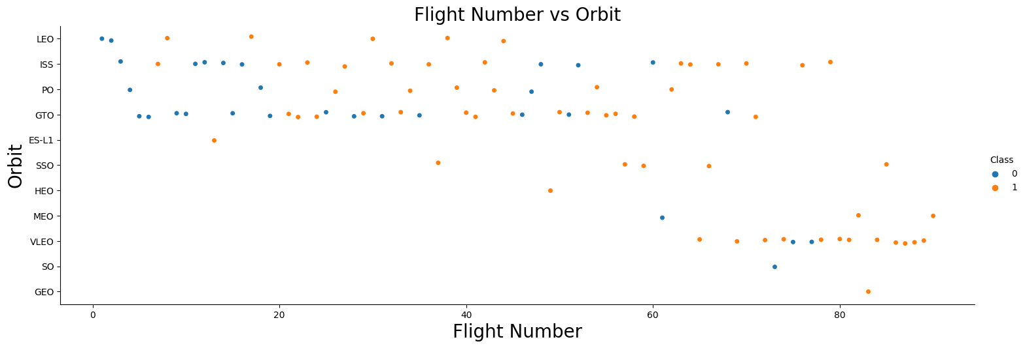
Flight Number vs. Orbit Type
This scatter plot visualizes the distribution of SpaceX's rocket launch attempts over time, categorizing them based on the orbit type. Each point on the plot represents a unique flight. The position on the x-axis corresponds to the flight number, which effectively also represents the chronological order of flights. The y-axis, on the other hand, shows the orbit type to which each flight was launched.
The color of each point indicates whether the launch was successful or not. Orange dots represent successful launches (Class 1), and blue dots represent unsuccessful ones (Class 0).
Key takeaways from this visualization:
Orbit Distribution Over Time: SpaceX has launched rockets to a variety of orbit types over time. Some orbit types, like VLEO, appear more frequently in later flights, indicating SpaceX's increasing engagement with these orbits.
Success Rate Over Time by Orbit Type: SpaceX's success rate appears to have improved over time across multiple orbit types, with the proportion of orange dots (successful launches) increasing with flight number.
Success Rate by Orbit Type: All orbit types have a mix of successful and unsuccessful launches. However, some orbits like ES-L1, SSO, and HEO appear to have a high success rate, while others like SO have a lower success rate.

Slide 22
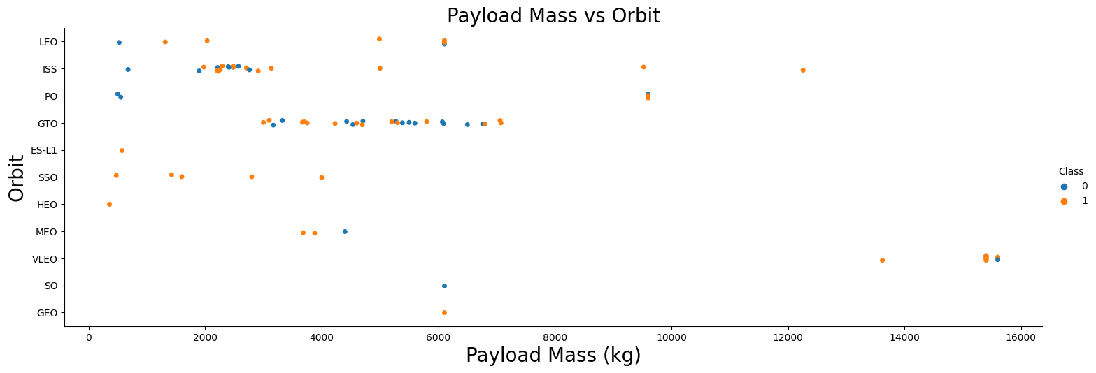
Payload vs. Orbit Type
This scatter plot illustrates the relationship between the payload mass and the orbit type for SpaceX's rocket launches. Each point on the plot represents a unique flight. The position on the x-axis corresponds to the payload mass, and the y-axis represents the orbit type to which each flight was launched.
The color of each point indicates whether the launch was successful or not. Orange dots represent successful launches (Class 1), and blue dots represent unsuccessful ones (Class 0).
Key takeaways from this visualization:
Payload Distribution by Orbit Type: Different orbit types can accommodate different ranges of payload mass. Specifically, ISS and GTO orbits have accommodated a wider range of payload masses compared to other orbits.
Success Rate by Payload Mass and Orbit Type: The success of launches varies across different payload masses and orbit types. For instance, the VLEO orbit accommodates only high payload masses, and these launches have been generally successful.
Successful Orbits: Some orbits, like SSO, show a 100% success rate in this dataset, indicating a consistent performance for launches to these orbits.

Slide 23
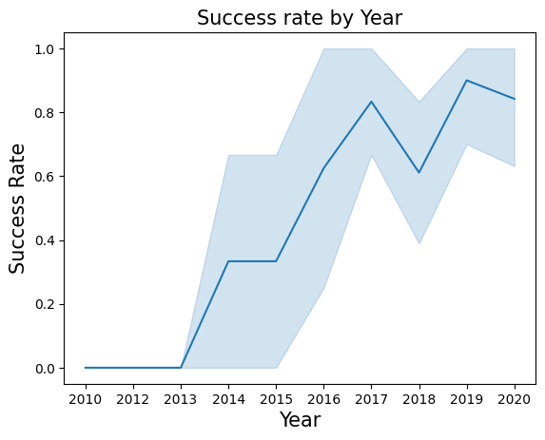
Launch Success Yearly Trend
This line chart illustrates the yearly trend of SpaceX's rocket launch successes. The x-axis represents the year of the launch, and the y-axis represents the proportion of successful launches within that year.
Key takeaways from this visualization:
Increasing Success Rate: There is a clear upward trend in the success rate of SpaceX launches over the years. This indicates improving performance and reliability in SpaceX's launch operations.

Slide 24
All Launch Site Names
Launch Site
CCAFS LC-40
VAFB SLC-4E
KSC LC-39A
CCAFS SLC-40
This table shows the distinct launch sites that SpaceX has utilized for their missions. The data is retrieved from the "SPACEXTBL" table in our database, which contains detailed records of SpaceX launches.

Slide 25
Launch Site Names Begin with 'CCA'
The table below shows five records of SpaceX launches where the launch sites begin with 'CCA'. This data was retrieved from the "SPACEXTBL" table in our database using the following SQL query:
Date | Time (UTC) | Booster Version | Launch Site | Payload | PAYLOAD MASS KG | Orbit | Customer | Mission Outcome | Landing Outcome
06/04/2010 | 18:45:00 | F9 v1.0 B0003 | CCAFS LC-40 | Dragon Spacecraft Qualification Unit | 0.0 | LEO | SpaceX | Success | Failure (parachute)
12/08/2010 | 15:43:00 | F9 v1.0 B0004 | CCAFS LC-40 | Dragon demo flight C1, two CubeSats, barrel of Brouere cheese | 0.0 | LEO (ISS) | NASA (COTS) NRO | Success | Failure (parachute)
22/05/2012 | 7:44:00 | F9 v1.0 B0005 | CCAFS LC-40 | Dragon demo flight C2 | 525.0 | LEO (ISS) | NASA (COTS) | Success | No attempt
10/08/2012 | 0:35:00 | F9 v1.0 B0006 | CCAFS LC-40 | SpaceX CRS-1 | 500.0 | LEO (ISS) | NASA (CRS) | Success | No attempt
03/01/2013 | 15:10:00 | F9 v1.0 B0007 | CCAFS LC-40 | SpaceX CRS-2 | 677.0 | LEO (ISS) | NASA (CRS) | Success | No attempt

Slide 26
Total Payload Mass
In this table we can see the total Payload Mass carried by boosters launched by NASA (CRS):
Customer | Total Payload Mass (kg)
NASA (CRS) | 45.596

Slide 27
Average Payload Mass by F9 v1.1
The following table shows the average Payload Mass carried only by the booster version F9 v1.1
Booster Version | AVG Payload Mass (kg)
F9 v1.1 | 2928.4

Slide 28
First Successful Ground Landing Date
Here we can see the date of the first successful landing on ground pad.
Date | Landing Outcome
22/12/2015 | Success (ground pad)

Slide 29
Successful Drone Ship Landing with Payload between 4000 and 6000
Booster Version | PAYLOAD MASS KG | Landing Outcome
F9 FT B1022 | 4696.0 | Success (drone ship)
F9 FT B1026 | 4600.0 | Success (drone ship)
F9 FT B1021.2 | 5300.0 | Success (drone ship)
F9 FT B1031.2 | 5200.0 | Success (drone ship)
These are the names of the boosters which have successfully landed on drone ship with a payload mass between 4000 and 6000 kg

Slide 30
Total Number of Successful and Failure Mission Outcomes
Successful Missions | Failed Missions
100 | 1
We have 100 Successful Missions vs. 1 Failed Mission. It's important to notice that a failed landing not necessarily is a failed mission, because most of the failed landings of SpaceX are actually planned.

Slide 31
Boosters Carried Maximum Payload
Booster Version | Payload Mass (kg)
F9 B5 B1048.4 | 15600.0
F9 B5 B1049.4 | 15600.0
F9 B5 B1051.3 | 15600.0
F9 B5 B1056.4 | 15600.0
F9 B5 B1048.5 | 15600.0
F9 B5 B1051.4 | 15600.0
F9 B5 B1049.5 | 15600.0
F9 B5 B1060.2 | 15600.0
F9 B5 B1058.3 | 15600.0
F9 B5 B1051.6 | 15600.0
F9 B5 B1060.3 | 15600.0
F9 B5 B1049.7 | 15600.0
This table shows the maximum Payload Mass with the names of the boosters that carried it.

Slide 32
2015 Launch Records
Month | Landing Outcome | Booster Version | Launch Site
10 | Failure (drone ship) | F9 v1.1 B1012 | CCAFS LC-40
04 | Failure (drone ship) | F9 v1.1 B1015 | CCAFS LC-40
Here we can see the booster versions and the launch sites for the 2015 failed landings in drone ship by month.

Slide 33
Rank Landing Outcomes Between 2010-06-04 and 2017-03-20
Landing Outcome | Total Outcomes
Success (drone ship) | 12
No attempt | 12
Success (ground pad) | 8
Failure (drone ship) | 5
Controlled (ocean) | 4
Uncontrolled (ocean) | 2
Precluded (drone ship) | 1
These are the total landing outcomes per type of outcome between 2010-06-04 and 2017-03-20
We can see that the drone ship has the most successful landing outcome between those dates.

Slide 34

Section 3

Slide 35
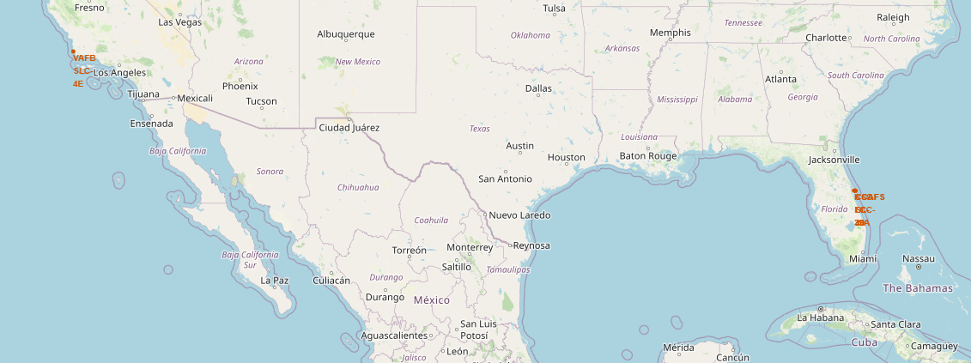
Launch Site Locations
Here we have all four possible locations of the launches with VAFB SLC-4E on the left side near Los Angeles and
CCAFS LC-40, CCAFS SLC-40 and KSC LC-39A on the right side.

Slide 36
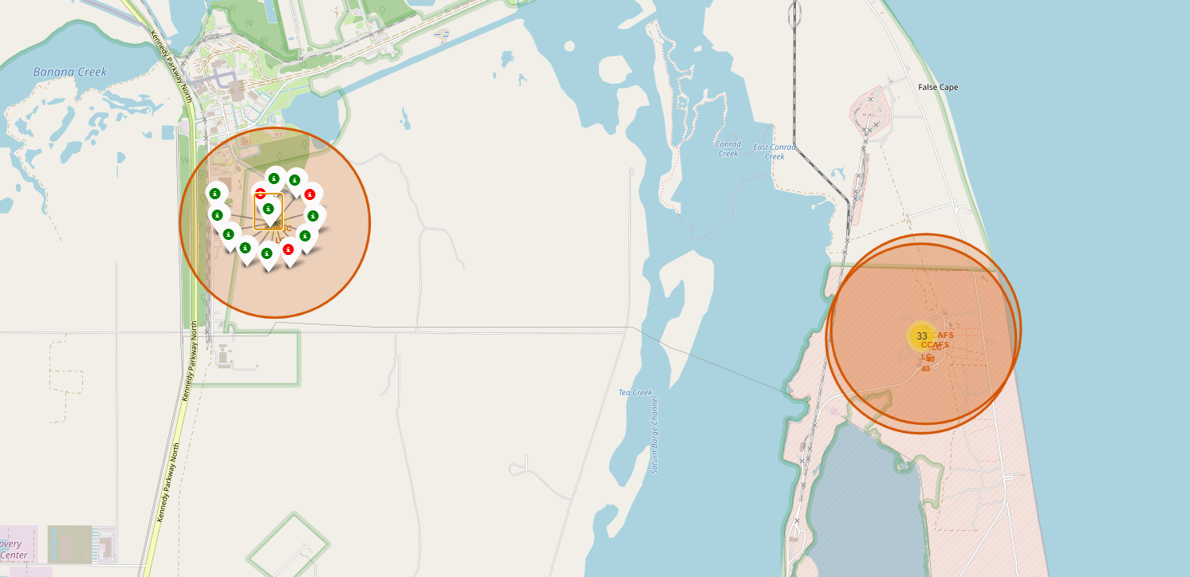
Launch Site Landing Outcomes
This map shows the landing outcomes of each launch for the location specified.
The green markers indicate the outcome was successful, while the red markers indicate the outcome was a failure.

Slide 37
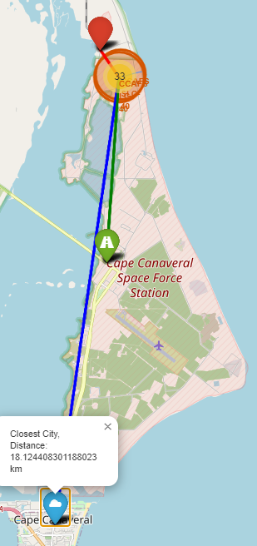
Launch Site Proximities Patterns
In this map we displayed the distances between this launch site and its closest coastline, highway, railway and city.
This way we could find patterns like launch sites keep certain distance away from cities, they tend to be close to railways, relatively close to highways and definitely close to coastlines.

Slide 38

Section 4

Slide 39
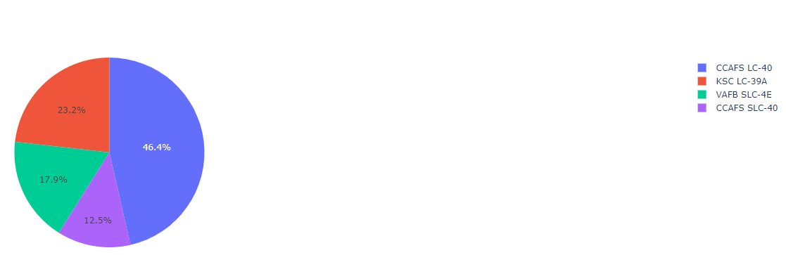
Successful Launches Per Launch Site
Dominance of CCAFS LC-40 launch site: This launch site is the most heavily used, with almost half (46.4%) of successful launches. This might suggest that this site has the most developed infrastructure, is more reliable, or is preferred for other reasons, such as its geographical location.

Slide 40
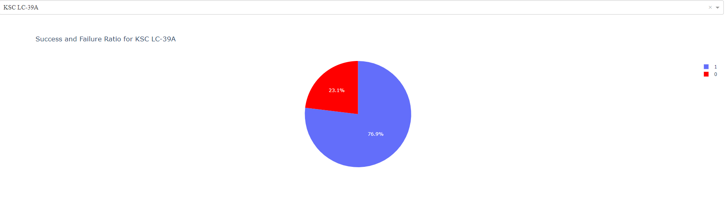
Launch Site With Highest Launch Success Ratio
This pie chart shows that the KSC LC-39A launch site has the highest success ratio with a 76.9% of success landings.

Slide 41
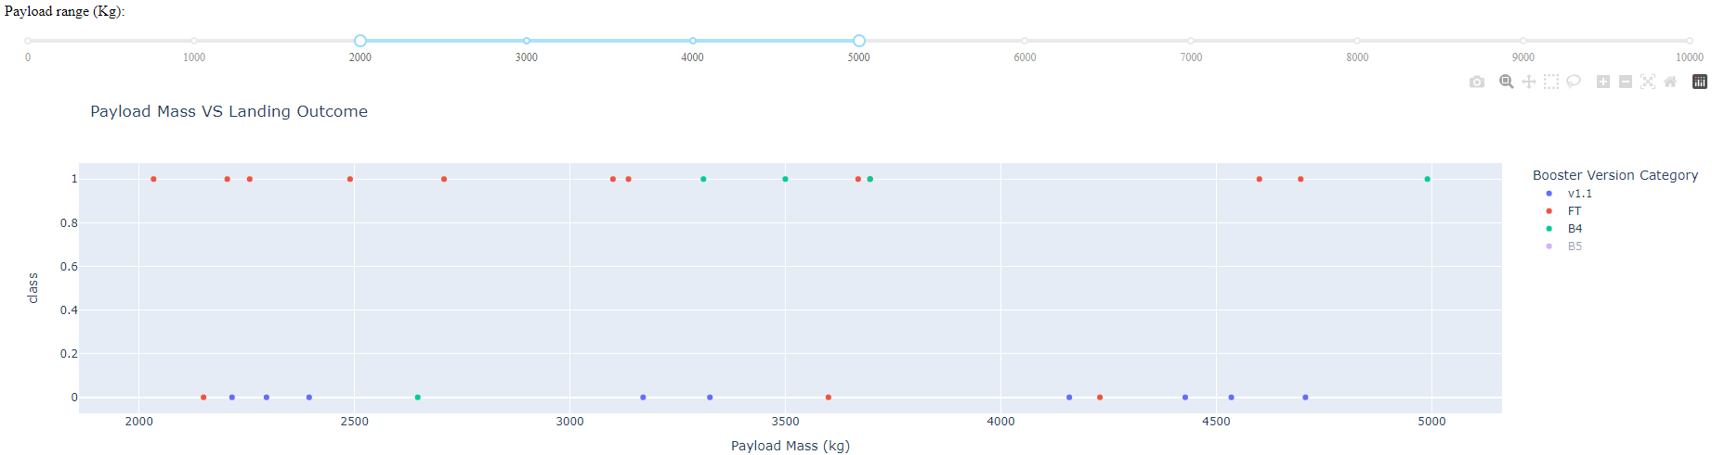
Success Ratio With 2000-5000 Payload Range
In this scatter plot we can easily see that in a range between 2000 and 5000 Payload Mass (kg), the booster version category with the highest success rate is the B4, with 4 success and just 1 failure.
In the other hand we can see the booster version category with the lowest success ratio is the v1.1 with no success and 9 failures.

Slide 42

Section 5

Slide 43
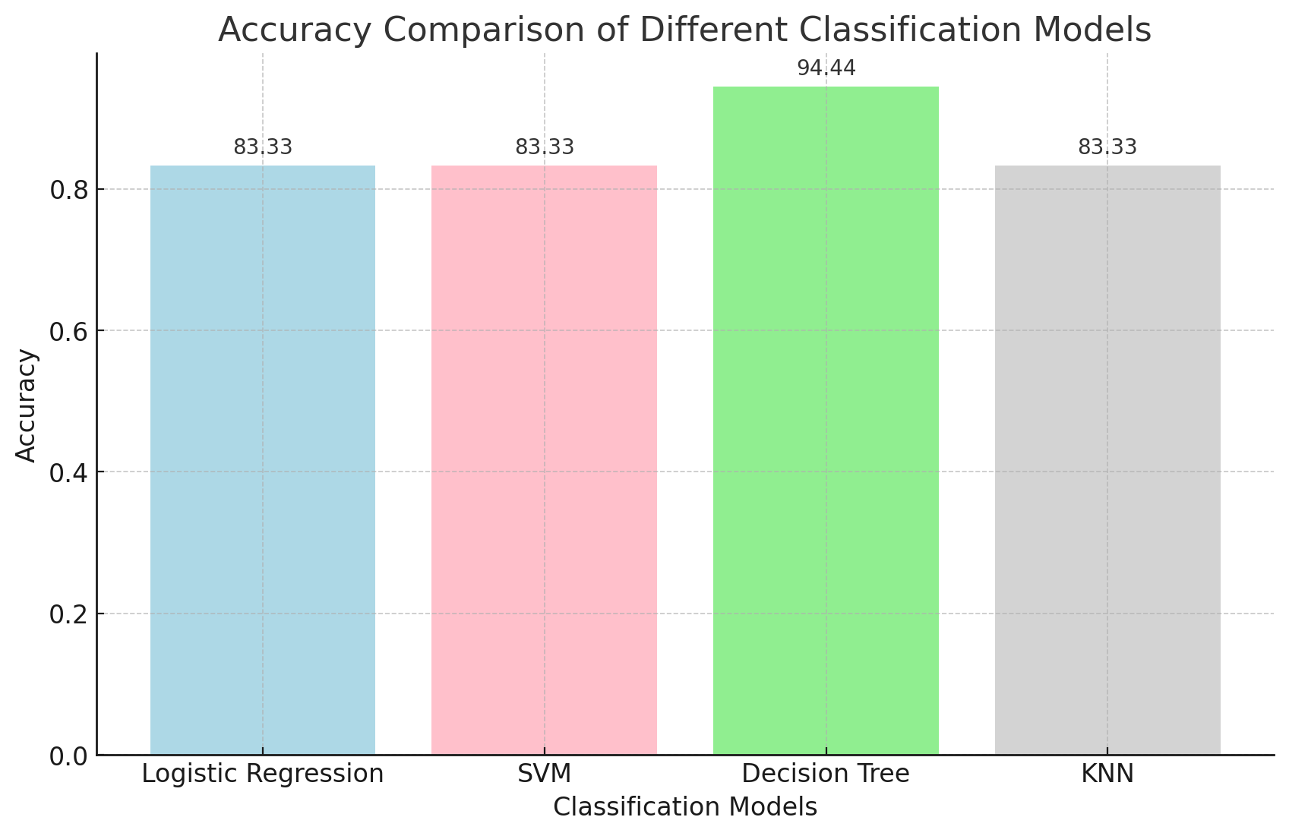
Classification Accuracy
The model with the highest accuracy is the Decision Tree model with a 94.44% of accuracy compared with 83.33% that each of the other models has.

Slide 44
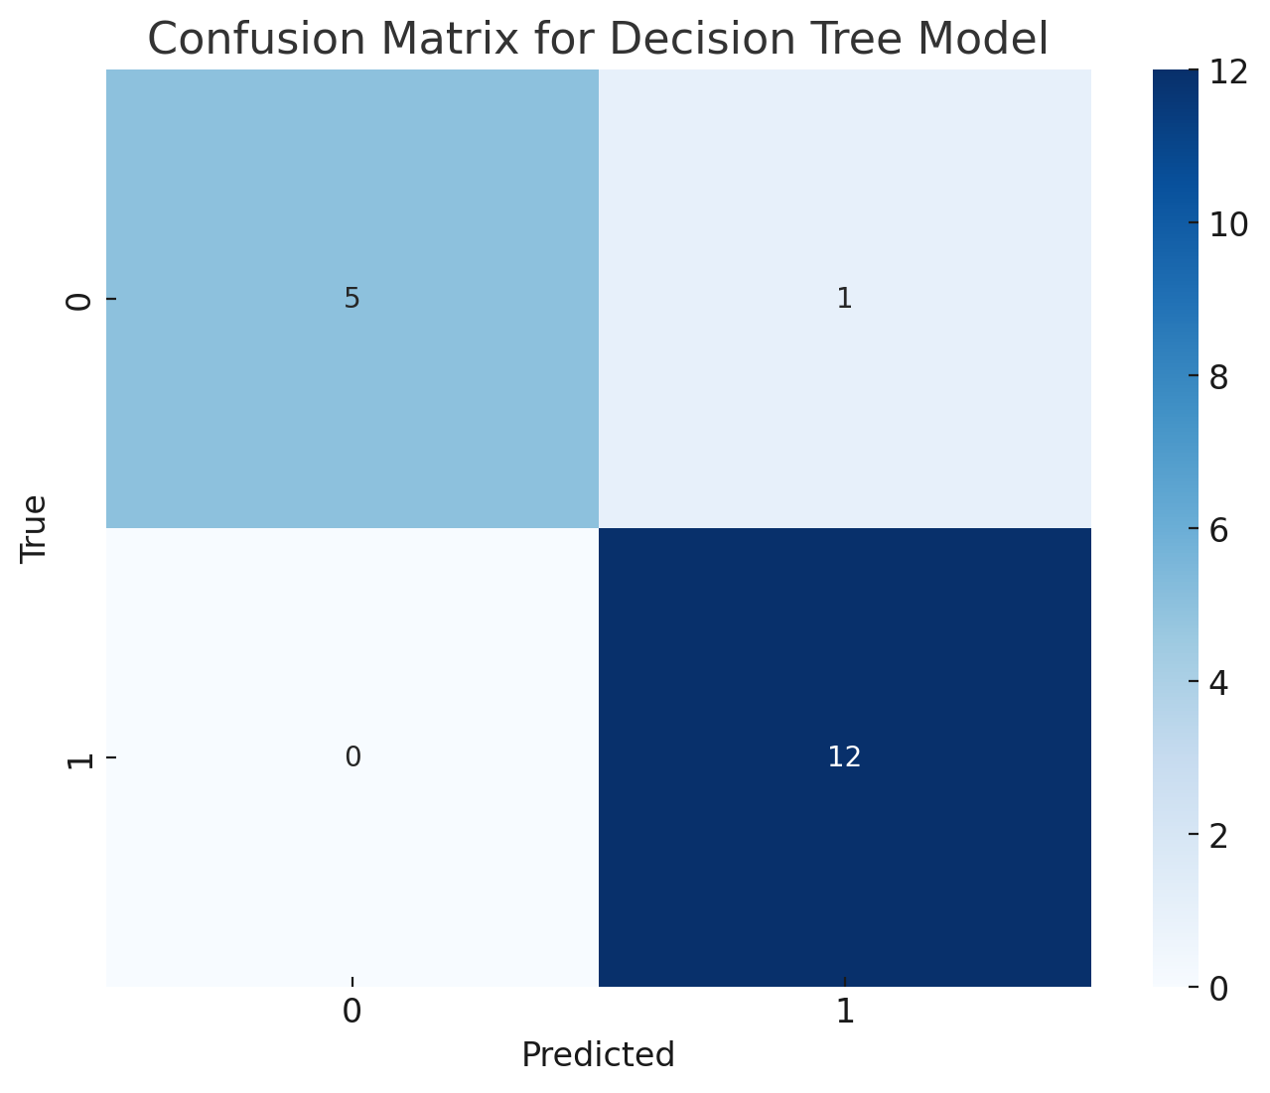
Confusion Matrix
This matrix shows that the model:
Correctly predicted 5 negative cases (true negatives).
Incorrectly predicted 1 case as positive that was actually negative (false positives).
Correctly predicted 12 positive cases (true positives).
Did not predict any cases as negative that were actually positive (false negatives).
In summary, the Decision Tree model performed very well on the test data, with only one case misclassified.

Slide 45
Conclusions
The project involved gathering data through SpaceX API calls and scraping a Wikipedia page to collect data on Falcon 9 launches. Gathering data from multiple sources allowed for a more comprehensive dataset for analysis.
In the data cleaning process, issues such as missing values, incorrect data types, and standardizing the data format were addressed. This allowed for more effective analysis and the building of more accurate models.
The exploratory data analysis involved generating various charts to better understand the data and uncover patterns, relationships, and trends. This provided valuable insights that helped guide the feature engineering and model building stages.
Predictive analyses were conducted using several classification algorithms, including Logistic Regression, Support Vector Machines (SVM), Decision Trees, and K-Nearest Neighbors (KNN). While all models initially performed similarly, the Decision Tree model ultimately achieved the highest accuracy with a score of 94.44%. This model was therefore selected as the best one. Factors such as model interpretability, training time, and simplicity were also considered during this selection process.
The project also involved creating interactive visualizations and dashboards using tools like Folium and Plotly Dash, allowing for a dynamic and interactive exploration of the SpaceX launch data.
Over time, the success rate of SpaceX launches has improved, as evidenced in the data visualizations. This indicates improved performance and reliability in SpaceX's launch operations.

Slide 46
Appendix
Here is the link to the github repository where you can find all the notebooks and the code for each task:
SpaceX_Project

Slide 47


